Slide 1
Fresh Grads – Group Project
Online Vegetable Sales Application

Slide 2
Problem Statement
To Create an Application for online Vegetable Shopping Application.
Customer should be able to purchase the vegetables.
Customer should be able to give feedback and rating about order
Admin should be able to mange the stock .

Slide 3
Road Map
Application will be developed in following Sprints –
Core Java +JPA with Hibernate
Spring Boot + Rest Controller + JPA with Hibernate
Angular for UI design (Front End) + Integration with previous Sprint

Slide 4
Plan
Design
Generate the skeleton as per class design provided
TDD approach
Identify test cases for each module
Write Failing Test cases
Convert the Test Cases in GREEN
Implement the case study in incremental manner

Slide 5
Modules
Login Module
Customer Module
Stock Management Module
Order Module
Bill Module
Payment Module

Slide 6
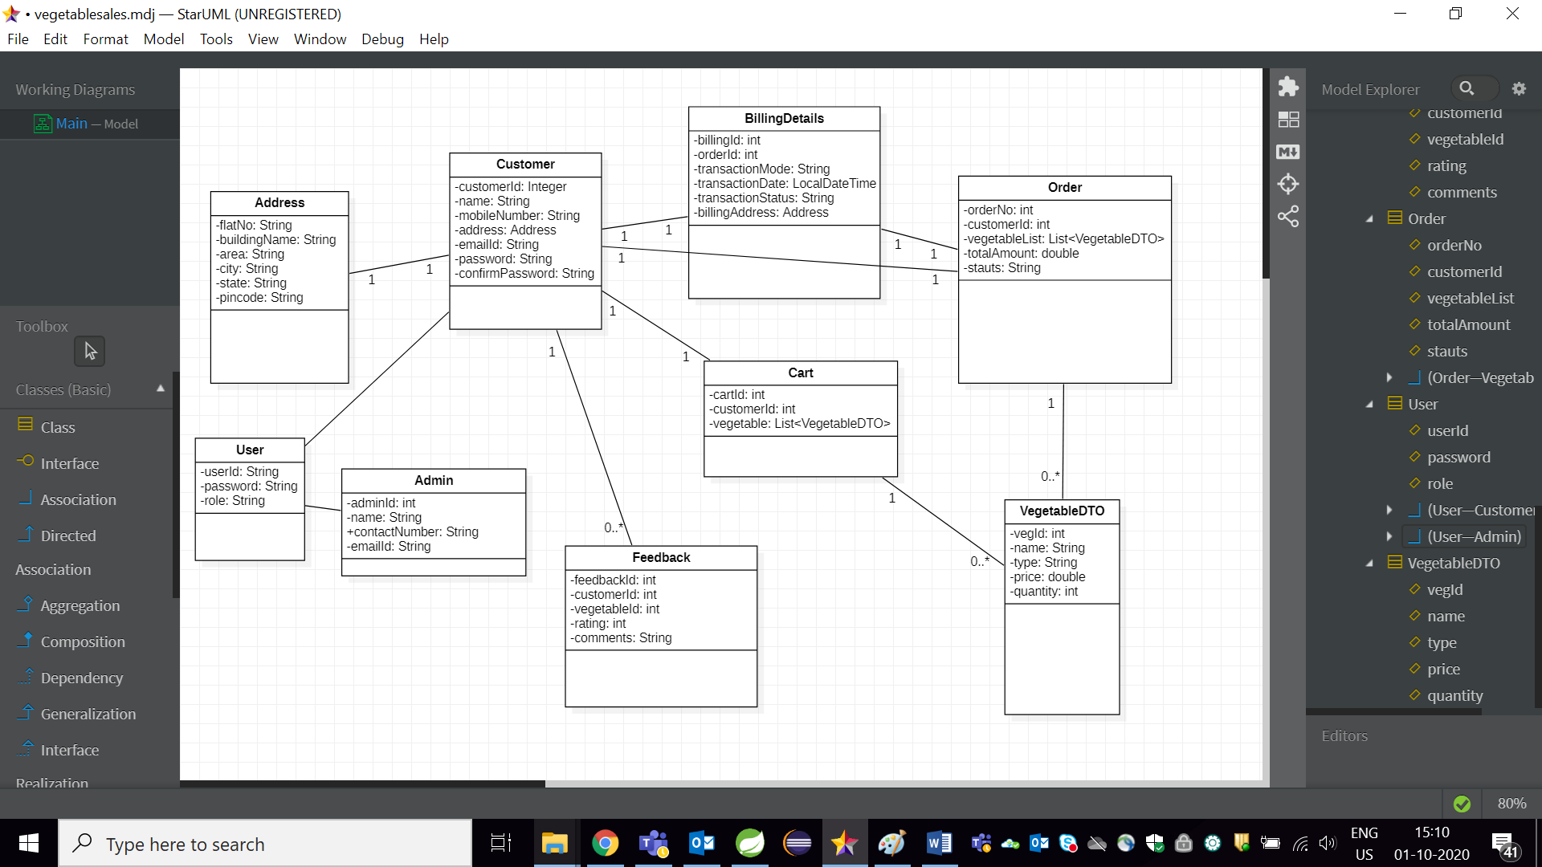
Class Design
POJO Classes:

Slide 7
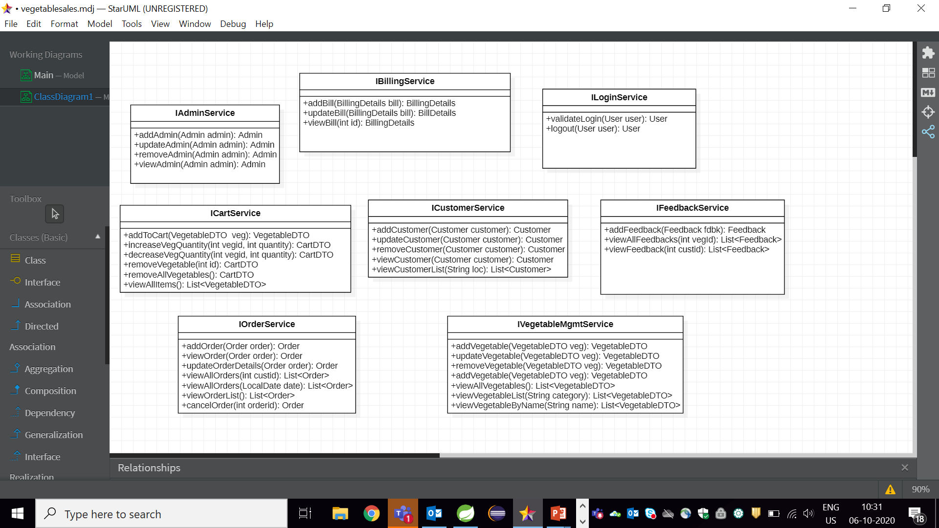
Class Design
Service Interface:

Slide 8
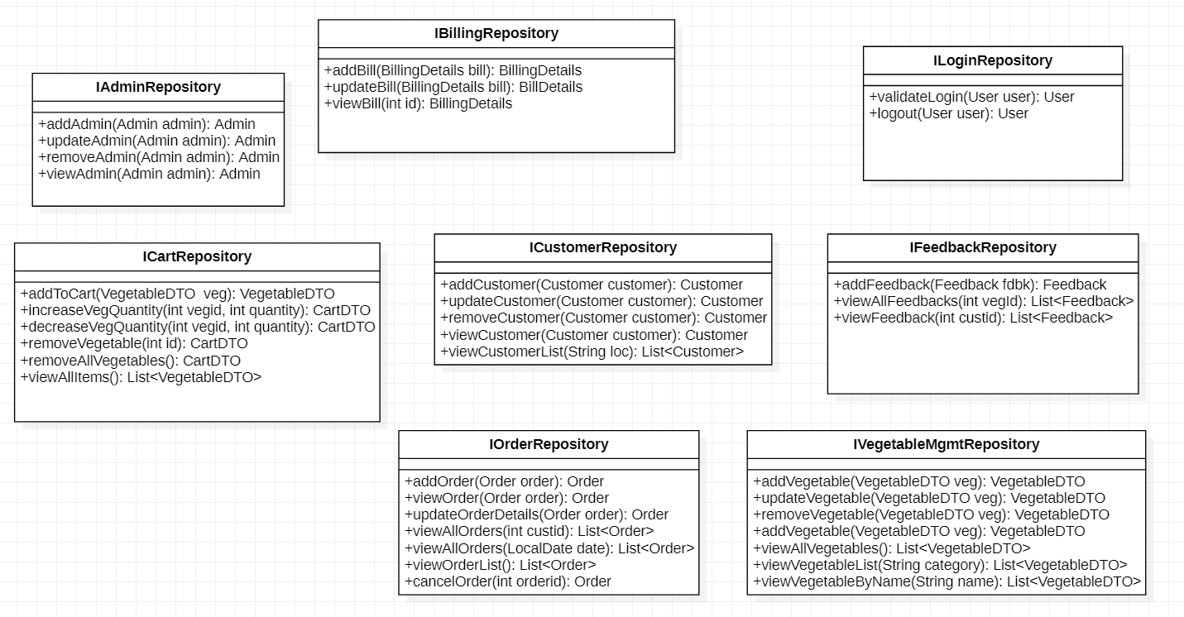
Class Design
Repository:

Slide 9




Questions

